Slide 1
The Forces on Falling Objects
CW #1
Problem:
How do the forces acting on an object affect the way the object falls?

Slide 2
SET UP YOUR PAPER LIKE THIS:
CW #1 THE FORCES ON FALLING OBJECTS
PART 1:
PROBLEM: How do the forces acting on an object affect the way the object falls?
PREDICTION:
RESULT:
EXPLANATION:
PREDICTION:
RESULT:
EXPLANATION:

Slide 3
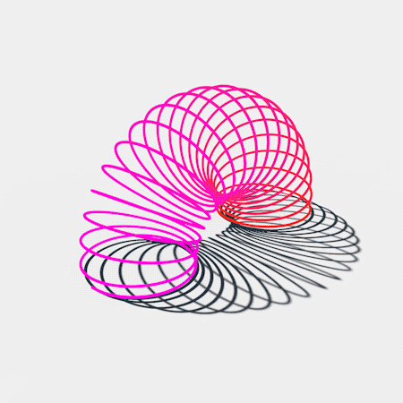
CW #1: Part I The Forces on Falling Objects Slinky drop intro
https://www.youtube.com/watch?v=wGIZKETKKdw

Slide 4
PREDICTION: (write your prediction on your paper)
Notes:
Pause for Students to sketch the gravity and tension forces acting on the slinky after

Slide 5
RESULT: (Use words, pictures or both to to show how the slinky fell)
https://www.youtube.com/watch?v=eCMmmEEyOO0&t=6s
Slinky drop and ball answer
Notes:
Pause for Students to sketch the gravity and tension forces acting on the slinky after

Slide 6
EXPLANATION: (Use words, pictures or both to explain why the slinky fell the way it did)
https://www.youtube.com/watch?v=eCMmmEEyOO0&t=6s
Slinky drop and ball answer
Notes:
Pause for Students to sketch the gravity and tension forces acting on the slinky after

Slide 7
PREDICTION: (write your prediction on your paper)
Notes:
Pause for Students to sketch the gravity and tension forces acting on the slinky after

Slide 8
RESULT: (Use words, pictures or both to to show how the slinky fell)
https://www.youtube.com/watch?v=oKb2tCtpvNU
Tennis ball slo mo answer
Notes:
Pause for Students to sketch the gravity and tension forces acting on the slinky after

Slide 9
EXPLANATION: (Use words, pictures or both to explain why the slinky fell the way it did)
https://www.youtube.com/watch?v=oKb2tCtpvNU
Tennis ball slo mo answer
Notes:
Pause for Students to sketch the gravity and tension forces acting on the slinky after

